Slide 1
ME751 Advanced Computational Multibody Dynamics
Inverse Dynamics
Equilibrium Analysis
Various Odd Ends
March 18, 2010
“Action speaks louder than words but not nearly as often..”
Mark Twain
© Dan Negrut, 2010 ME751, UW-Madison

Slide 2
Before we get started…
Last Time:
Learn how to obtain EOM for a 3D system: the r-p formulation
Today:
Super briefly talk about the EOM when using Euler Angles
Discuss two classes of forces likely to be encountered in Engineering Apps
Inverse Dynamics Analysis
Equilibrium Analysis
Final Project:
Feedback: http://sbel.wisc.edu/Courses/ME751/2010/Documents/FinalProjectRelated/finalProjectProposals.pdf
I need your final version of the proposal. Some might have to modify first draft, some we’ll have to work a bit on the document
This is part of HW, will have to be turned in with the handwritten part of the HW on March 25
This version is what I’ll use to evaluate your work
HW due on Th, March 25 posted online
For the MATLAB part please email from now on your zipped files to Naresh (the TA)

Slide 3
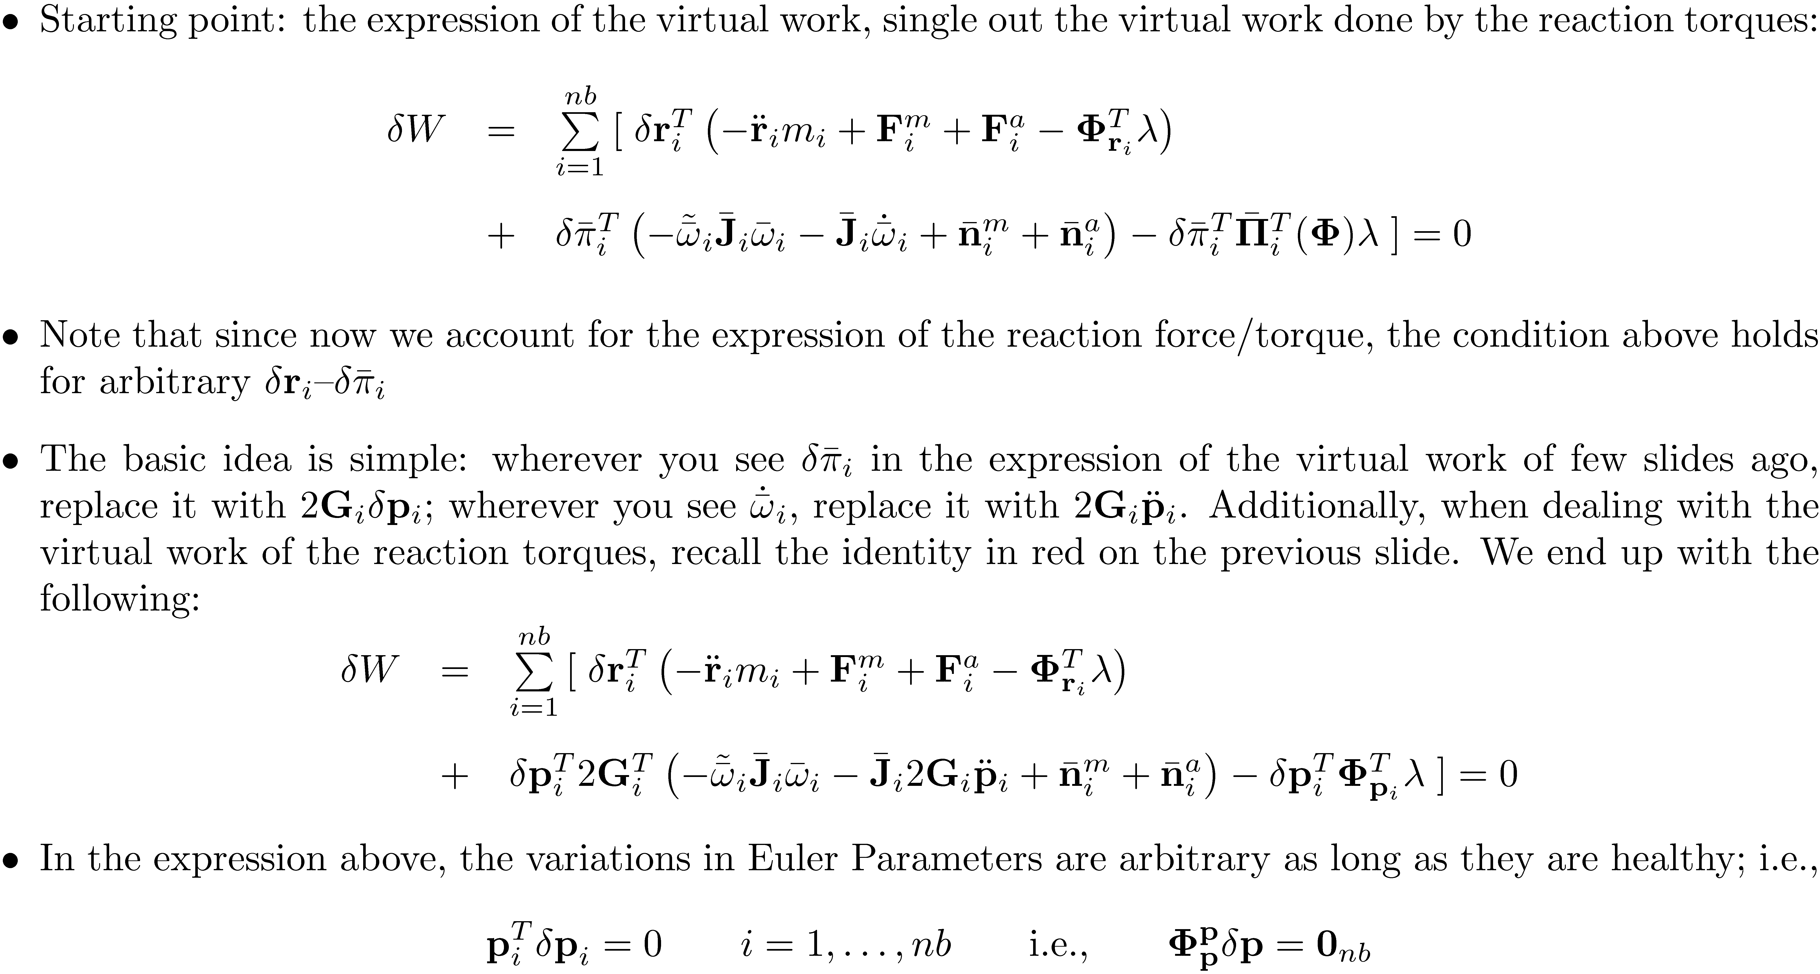
The Formulation of the EOM Using Euler Angles

Slide 4
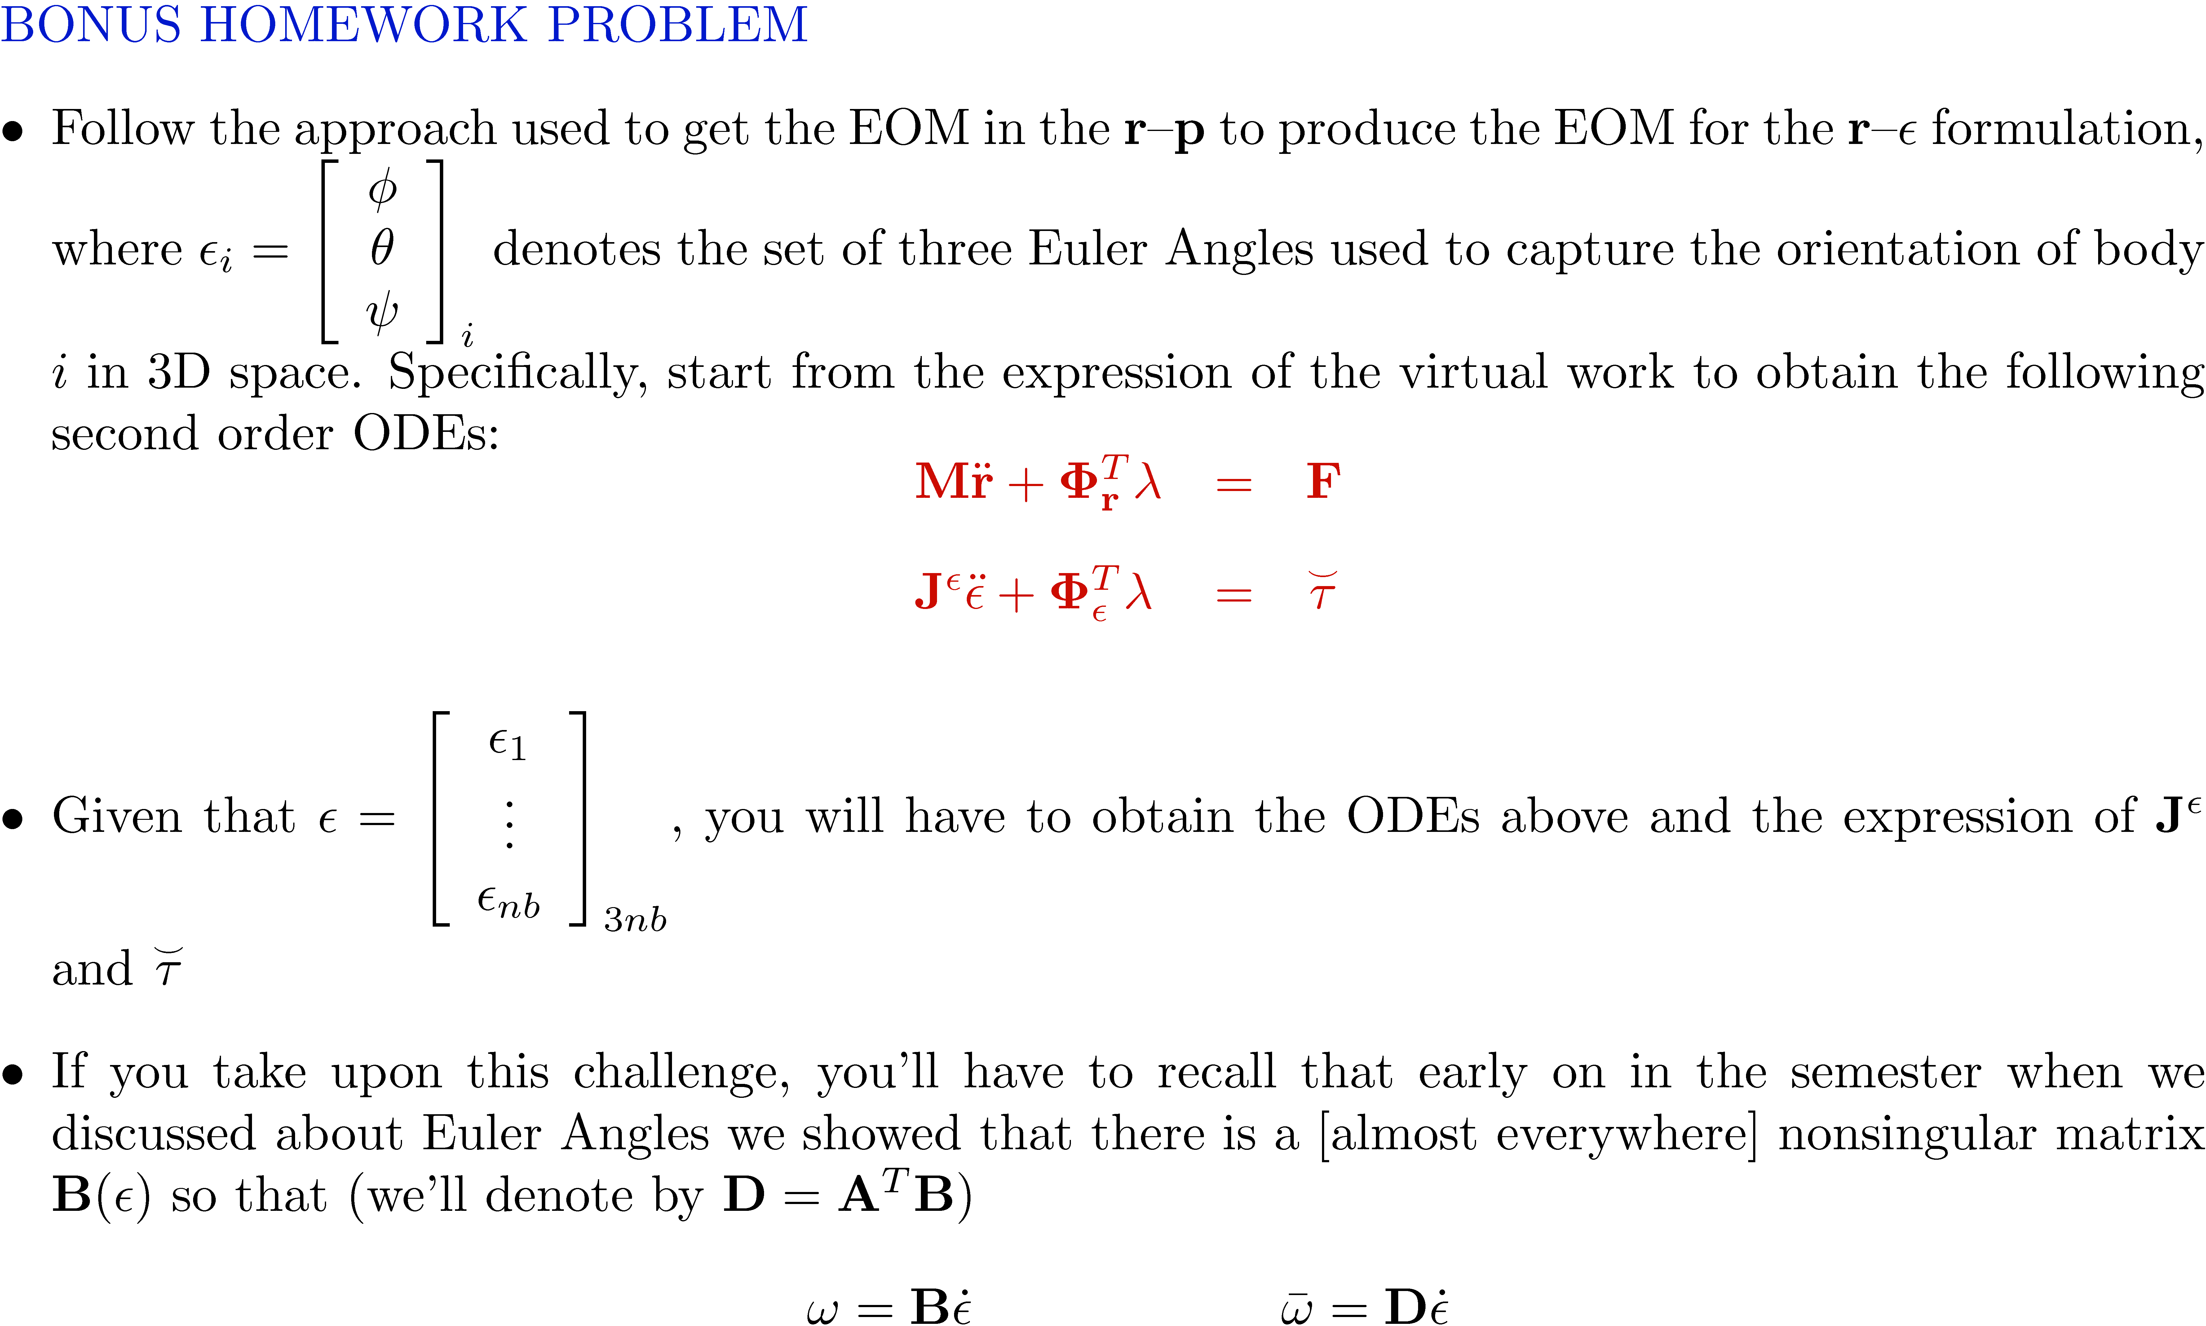
The Formulation of the EOM Using Euler Angles

Slide 5
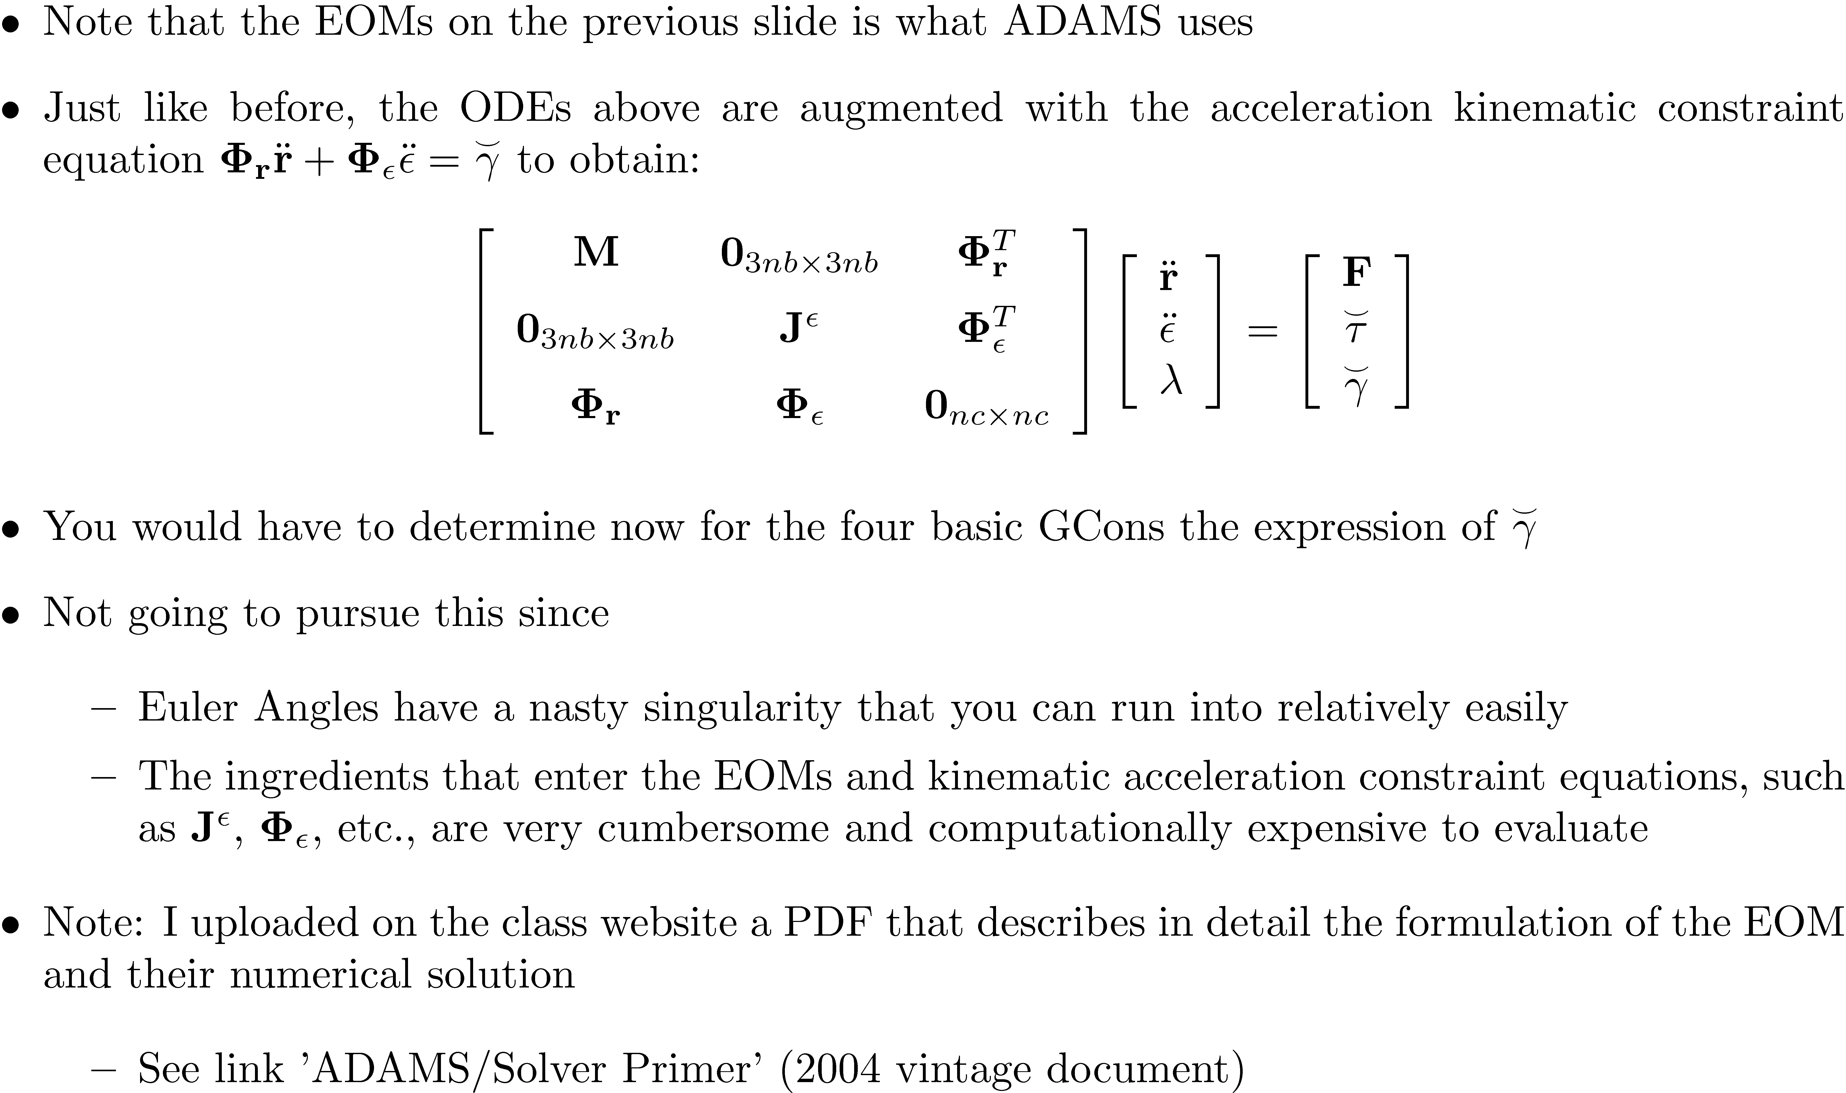
The Formulation of the EOM Using Euler Angles [Cntd.]

Slide 6
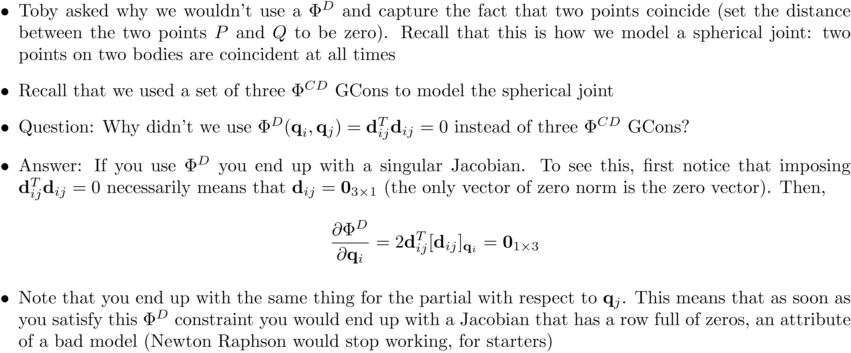
Modeling Pitfall [1/3] [Short Detour]

Slide 7
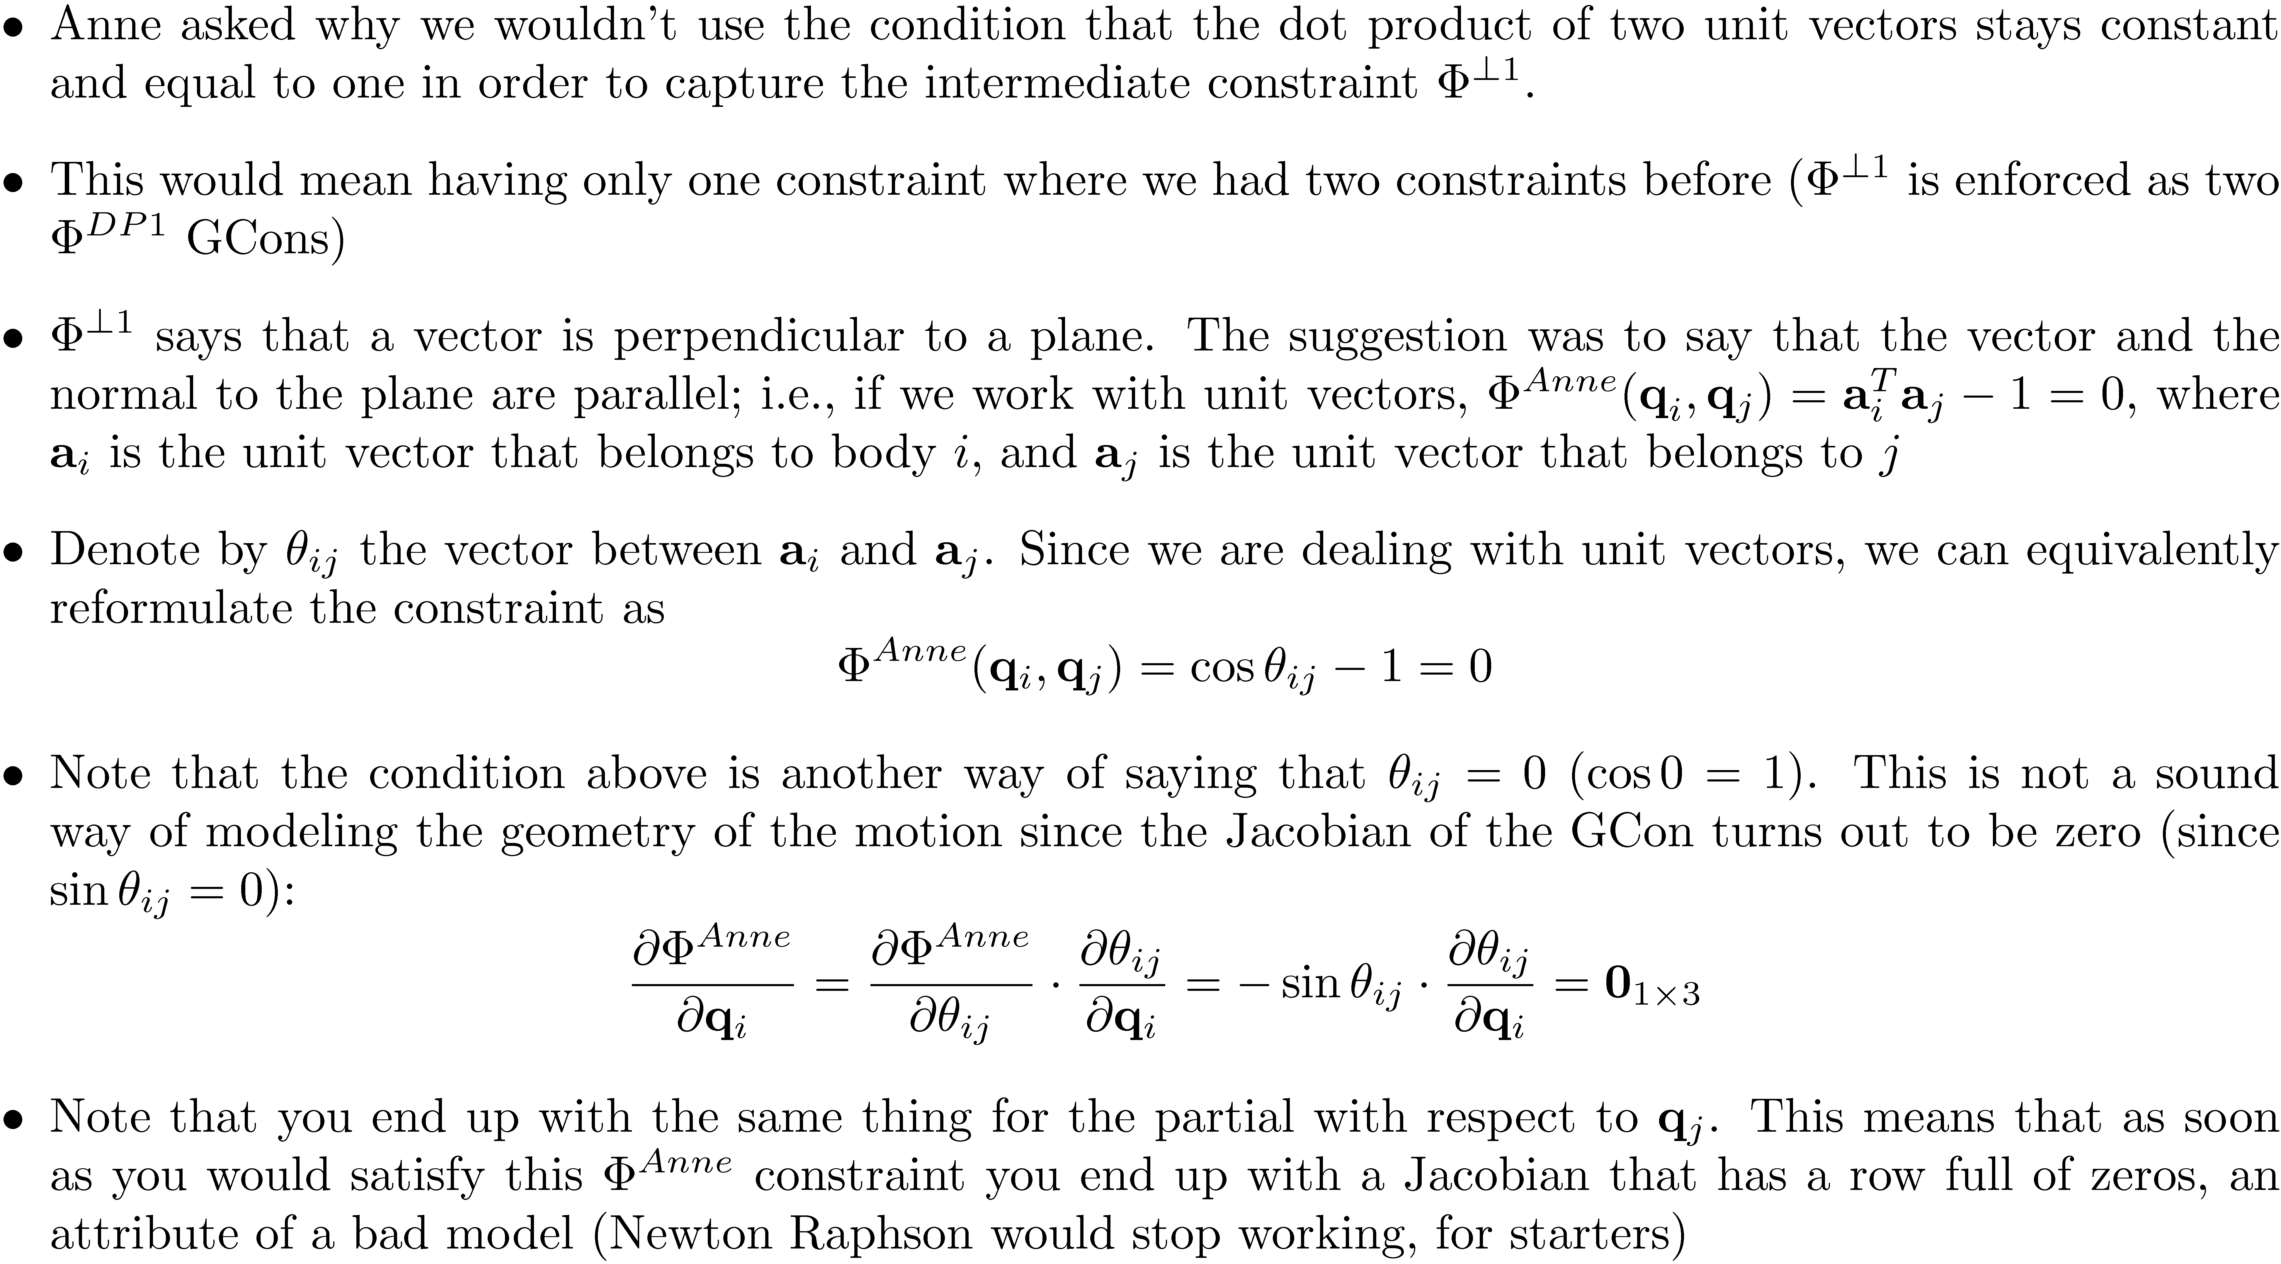
Modeling Pitfall [2/3] [Short Detour]

Slide 8
Modeling Pitfall [3/3] [Short Detour]
The singularity you got in your Jacobian in HW8 if you defined the driving constraint using two collinear vectors can be traced back to the discussion on the previous slide
Anne used the pseudoinverse of the Jacobian, but that’s not the right way to go about it since it concentrates on the effect rather the cause of the problem
Tyler and Jim suggested changing the vectors used to model the constraints
Rather than using two collinear vectors, they used two vectors that were at ¼/2
This was the good solution
This was a topic on discussion on the forum

Slide 9
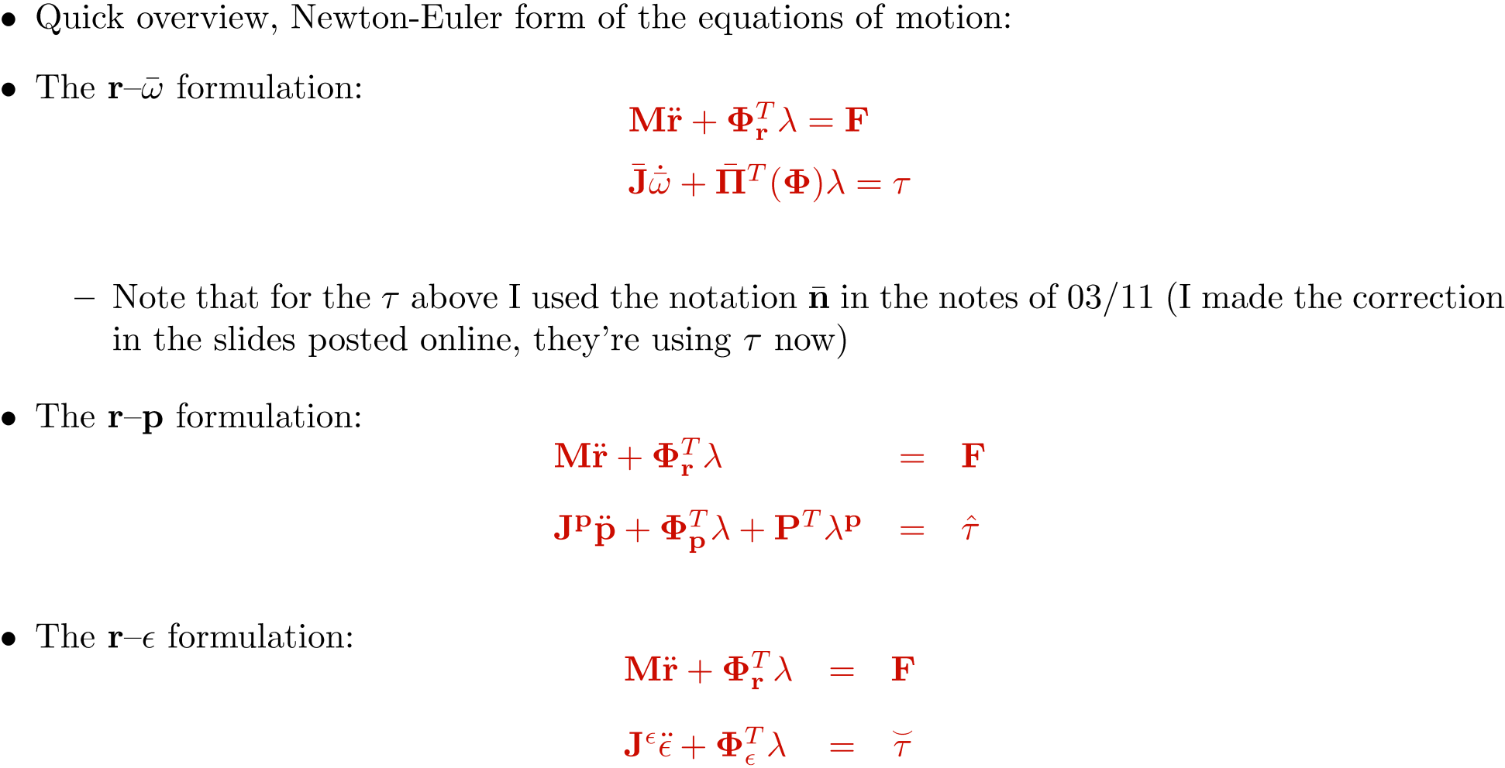
Dynamics in the Absence of Constraints

Slide 10
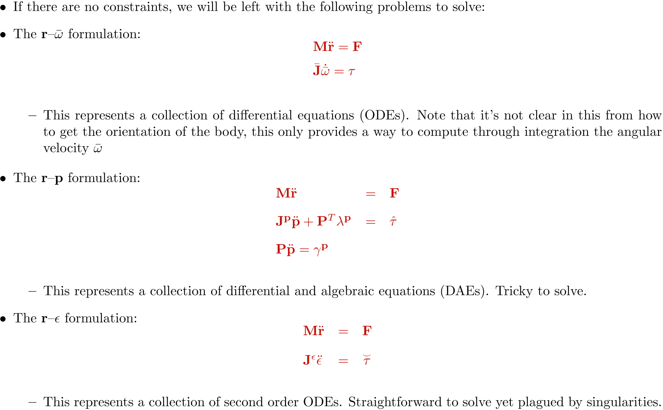
Dynamics in the Absence of Constraints

Slide 11
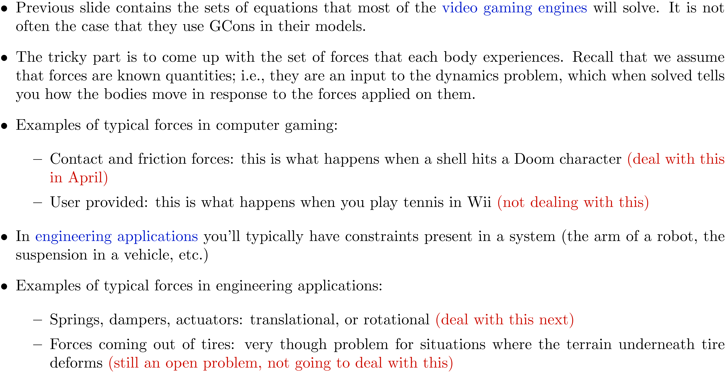
Comments

Slide 12
Discussion on Applied Forces and Torques

Slide 13
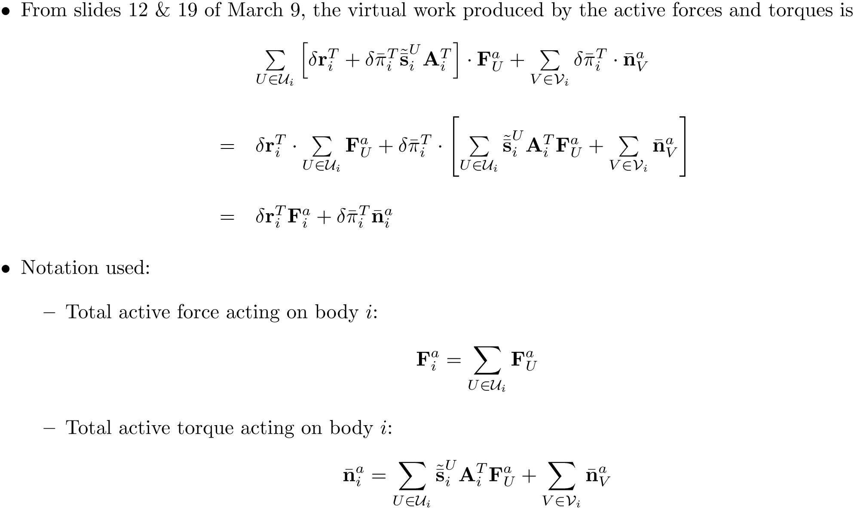
Virtual Work: Contribution of concentrated forces/torques

Slide 14
Concentrated Forces: TSDA (Translational Spring-Damper-Actuator) – pp.445
Setup: You have a translational spring-damper-actuator acting between point P_{i} on body i, and P_{j} on body j
Translational spring, stiffness k
Zero stress length (given): l₀
Translational damper, coefficient c
Actuator (hydraulic, electric, etc.) – symbol used “h”

Slide 15
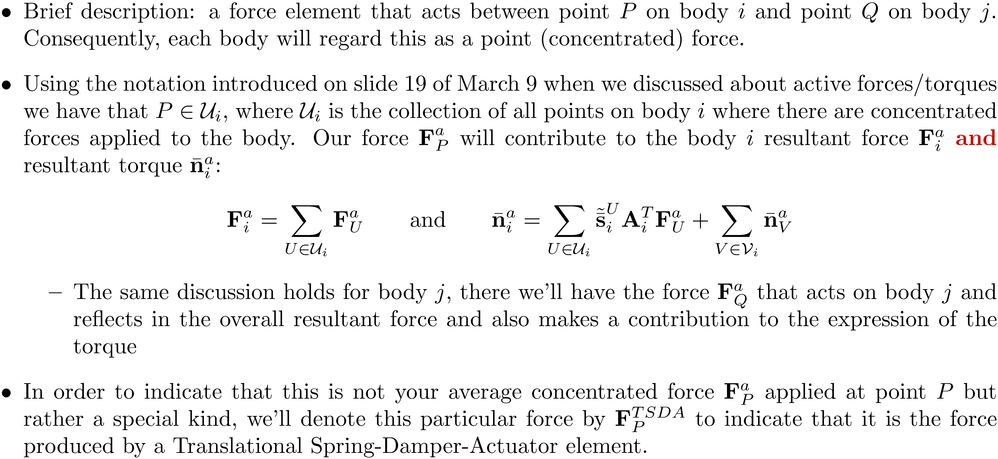
Concentrated Forces: TSDA

Slide 16
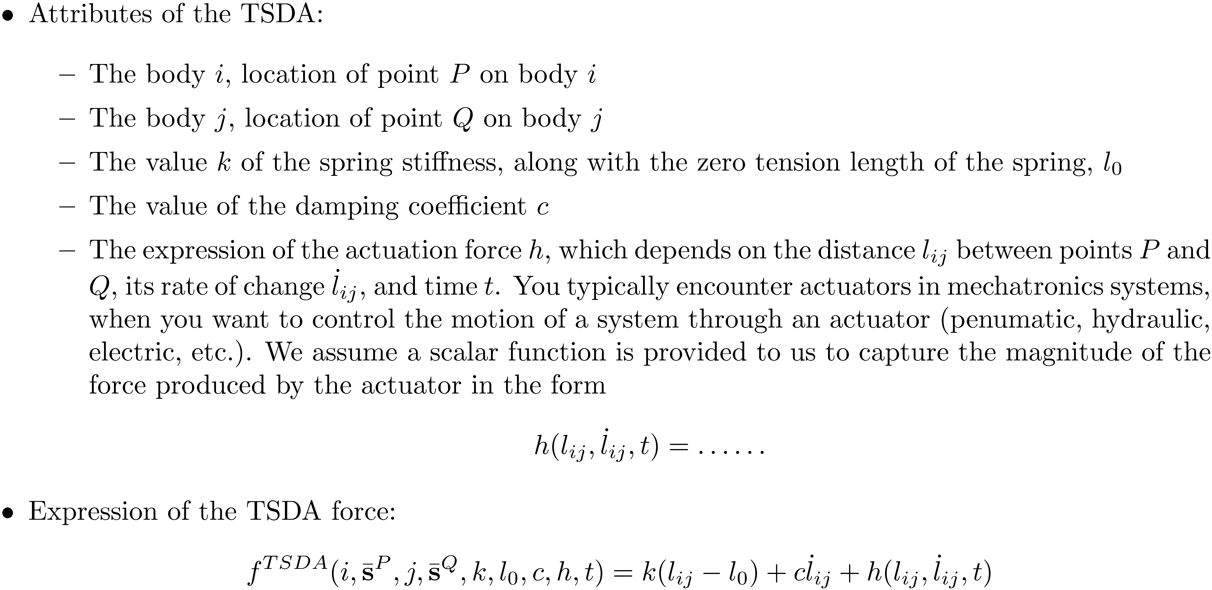
Concentrated Forces: TSDA

Slide 17
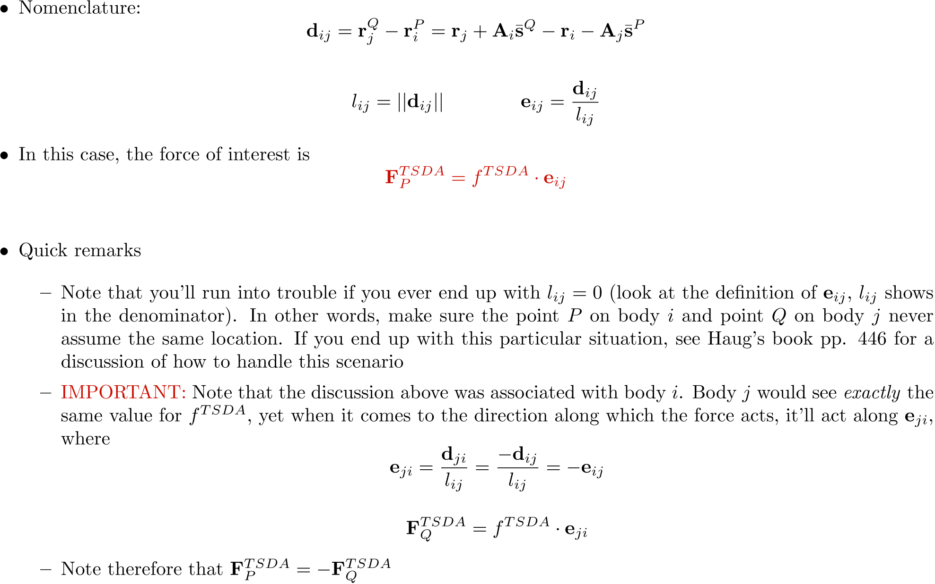
Concentrated Forces: TSDA

Slide 18
Concentrated Torques: RSDA (Rotational Spring-Damper-Actuator) – pp.448
Setup: You have a rotational spring-damper-actuator acting between two lines, each line rigidly attached to one of the bodies (dashed lines in figure)
Rotational spring, stiffness k
Rotational damper, coefficient c
Actuator (hydraulic, electric, etc.) – symbol used “h”

Slide 19
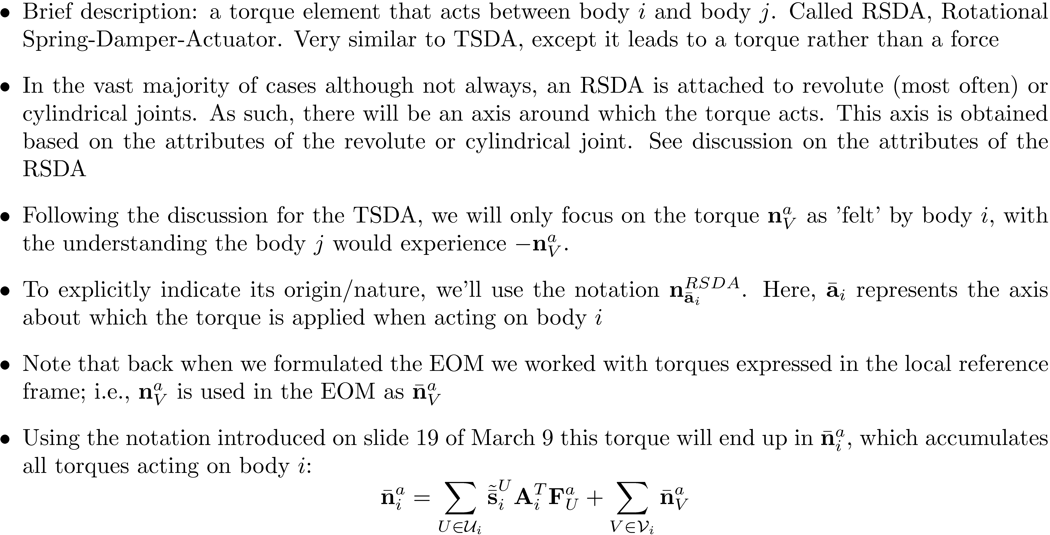
Virtual Work: Contribution of the active forces/torques

Slide 20
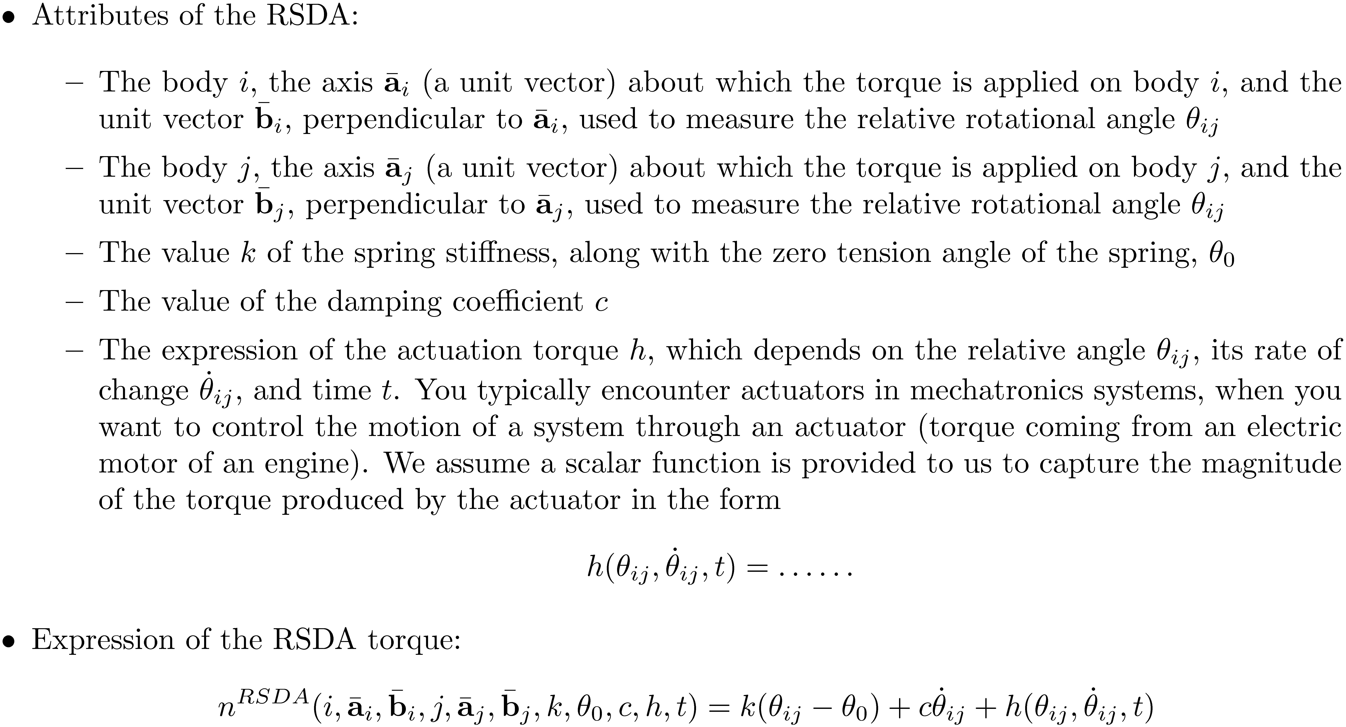
Concentrated Torques: RSDA

Slide 21
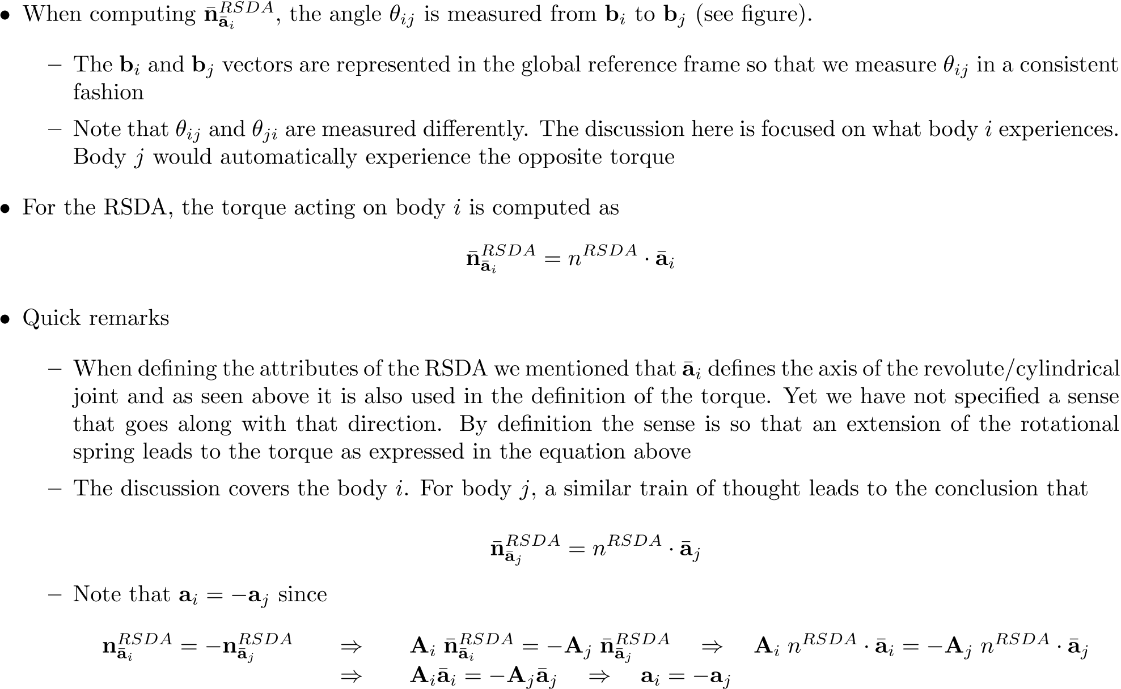
Concentrated Torques: RSDA

Slide 22
End EOM Beginning Inverse Dynamics Analysis

Slide 23
[New Topic] Inverse Dynamics: The idea
First of all, what does dynamics analysis mean?
You apply some forces/torques on a mechanical system and look at how the configuration of the mechanism changes in time
How it moves also depends on the ICs associated with that mechanical system
In *inverse* dynamics, the situation is quite the opposite:
You specify a motion of the mechanical system and you are interested in finding out the set of forces/torques that were actually applied to the mechanical system to lead to this motion
When is *inverse* dynamics useful?
It’s useful in controls. For instance in controlling the motion of a robot: you know how you want this robot to move, but you need to figure out what joint torques you should apply to make it move the way it should

Slide 24
Inverse Dynamics: The Math
When can one talk about Inverse Dynamics?
Given a mechanical system, a prerequisite for Inverse Dynamics is that the number of degrees of freedom associated with the system is zero
You have as many generalized coordinates as constraints (THIS IS KEY)
This effectively makes the problem a Kinematics problem. Yet the analysis has a Dynamics component since you need to compute reaction forces
The Process (3 step approach):
STEP 1: Solve for the accelerations using *exclusively* the set of constraints (the Kinematics part)
STEP 2: Computer next the Lagrange Multipliers using the Newton-Euler form of the EOM (the Dynamics part)
STEP 3: Once you have the Lagrange Multipliers, pick the ones associated with the very motions that you specified, and compute the reaction forces and/or torques you need to get the prescribed motion[s]

Slide 25
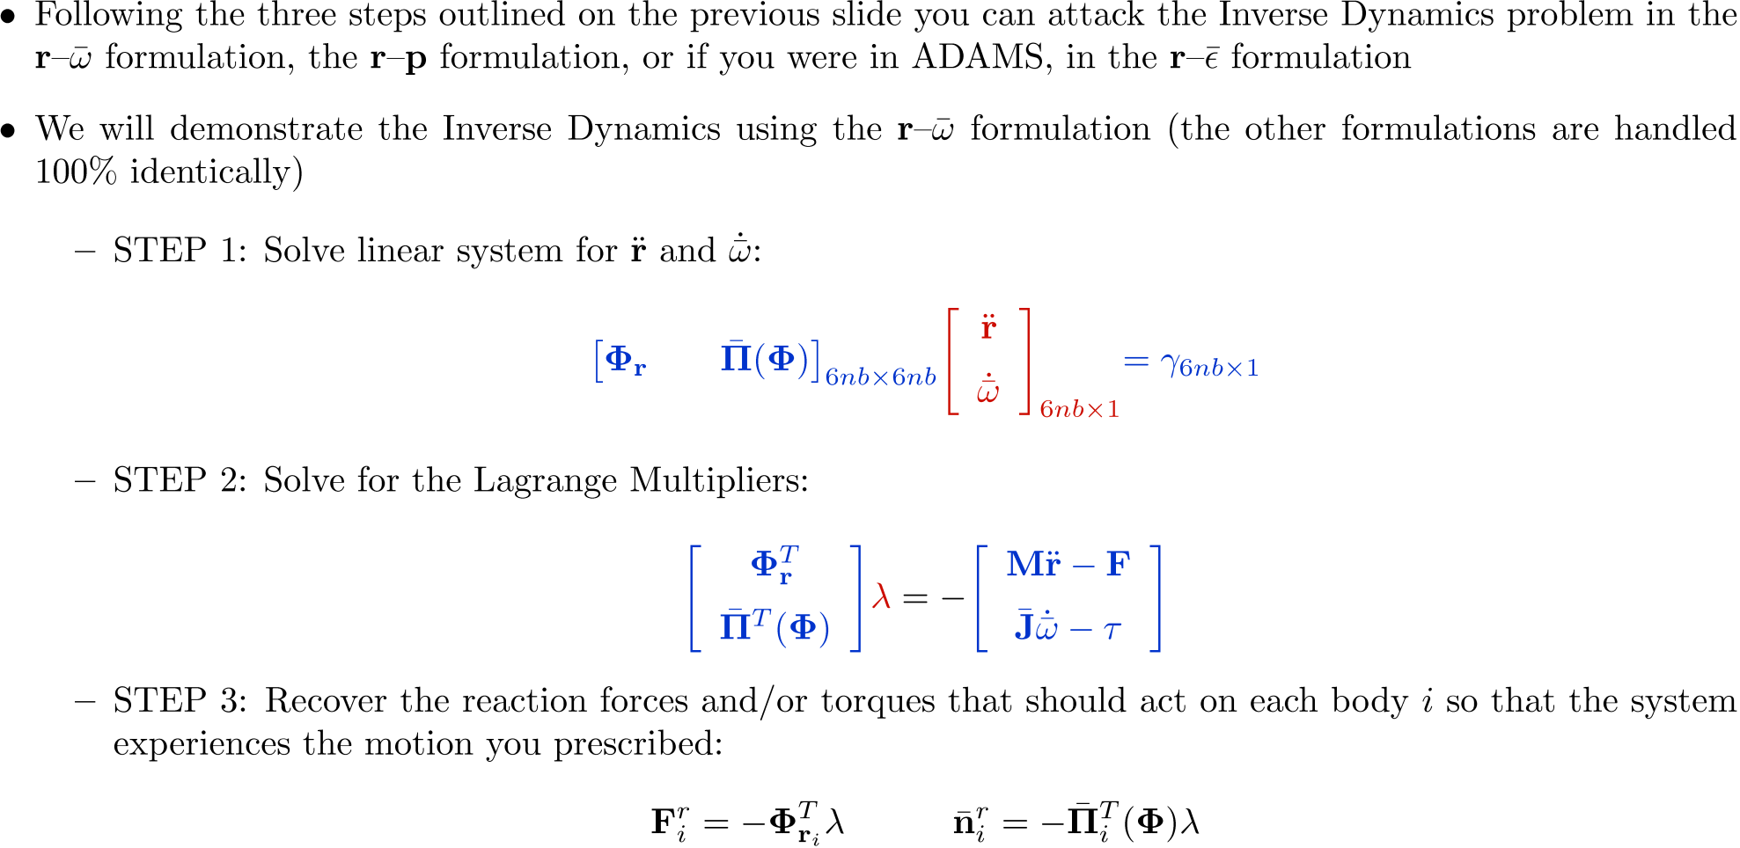
Inverse Dynamics: The Math

Slide 26
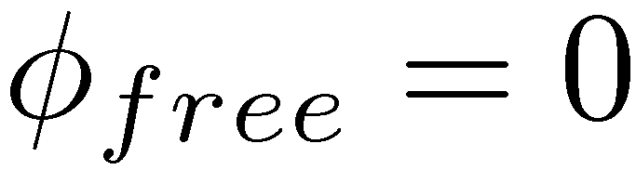
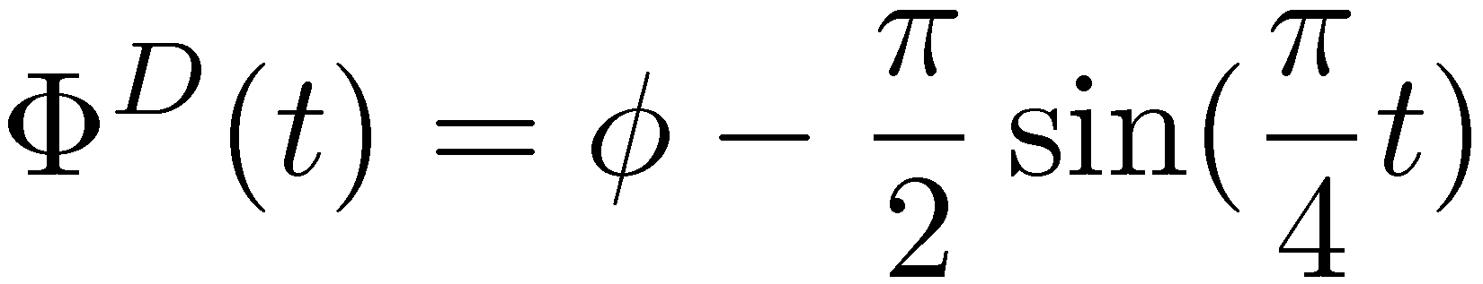
[AO – ME451] Example: Inverse Dynamics
Door Mass m = 30
Mass Moment of Inertia J’ = 2.5
Spring/damping coefficients:
K = 8 C = 1
All units are SI.
Zero Tension Angle of the spring:
Compute torque that electrical motor applies to open handicapped door
Apply motion for two seconds to open the door like

Slide 27
End Inverse Dynamics Beginning Equilibrium Analysis

Slide 28
[New Topic] Equilibrium Analysis: The Idea
A mechanical system is in equilibrium if the system is at rest, with zero acceleration
So what does it take to be in this state of equilibrium?
You need to be in a certain configuration q
The reaction forces; that is, Lagrange Multipliers, should assume certain values
As before, it doesn’t matter what formulation you use, in what follows we will demonstrate the approach using the r-p formulation
At equilibrium, we have that

Slide 29
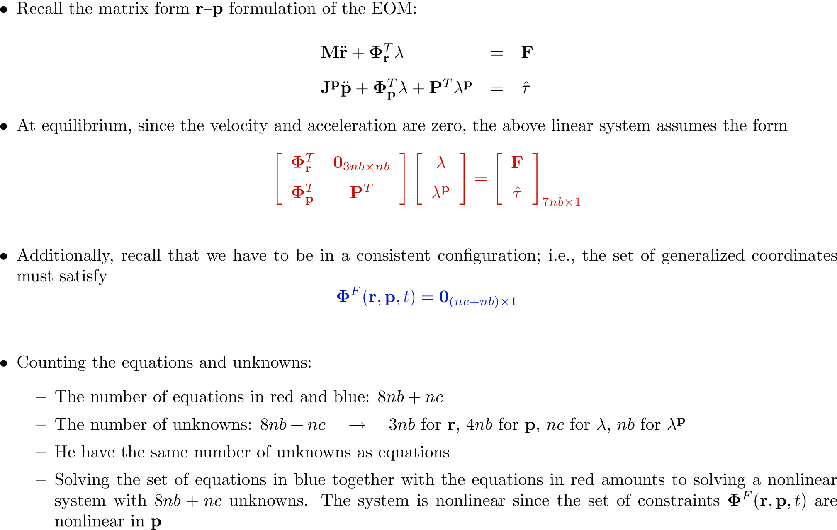
Equilibrium Analysis: The Math

Slide 30
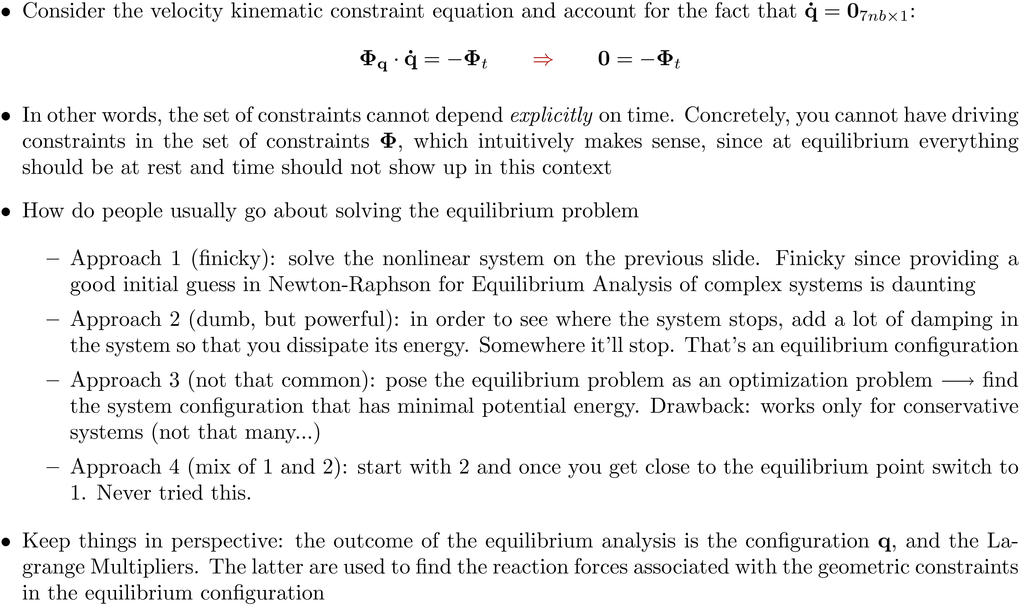
Equilibrium Analysis: Closing Remarks

Slide 31
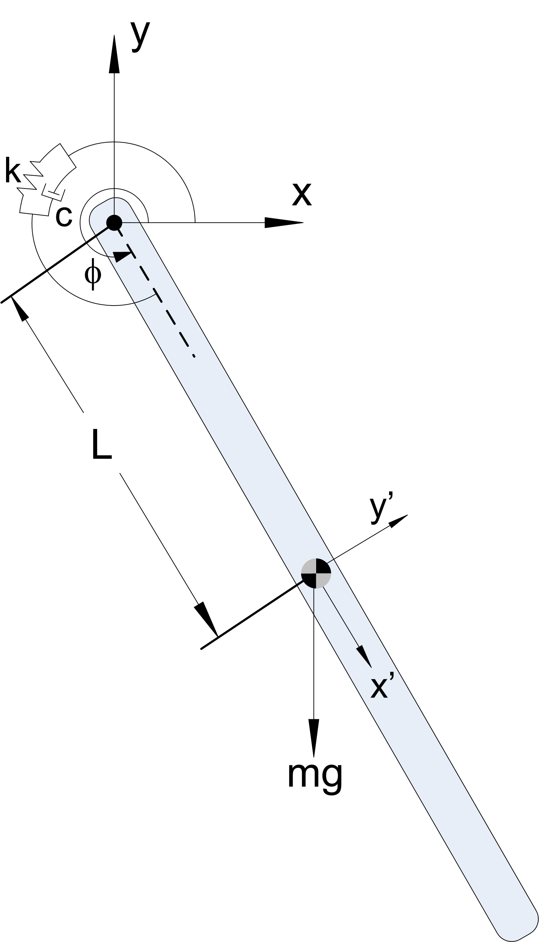
[AO-ME451] Example: Equilibrium Analysis
Find the equilibrium configuration of the pendulum below
Pendulum connected to ground through a revolute joint and rotational spring-damper element
Free angle of the spring:
Spring constant: k=25
Mass m = 10
Length L=1
All units are SI.

